Slide 1
Developing Apps for Touch and Mobile Devices

Slide 2
Objectives
In this session, you will learn to:
  Work with Apache Cordova
  Work with PhoneGap Build

Slide 3
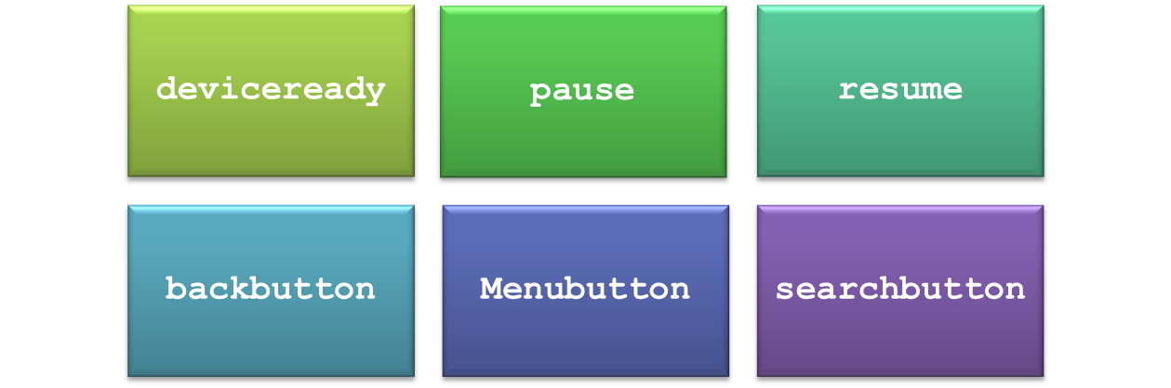
Implementing Apache Cordova Lifecycle Events
While developing a cross-platform app using Apache Cordova, you might want to implement various functionalities.
This can be done by implementing the various Apache Cordova lifecycle events.
Apache Cordova lifecycle events are the predefined events that replace the native events of the platform and perform similar tasks.
The lifecycle events are:

Slide 4

Implementing Apache Cordova Lifecycle Events (Contd.)
deviceready
The deviceready event is necessary in every application.
This event signifies that the Cordova APIs have loaded successfully and are ready for access.
The following code snippet can be used to implement the deviceready event:
document.addEventListener("deviceready", onDeviceReady, false);
function onDeviceReady() {
// Code to use Cordova APIs.
}

Slide 5
Implementing Apache Cordova Lifecycle Events (Contd.)
pause
The pause event is executed when the native platform puts the application into the background or the user starts using a different application.
The following code snippet can be used to implement the pause event:
document.addEventListener("pause", onPause, false);
function onPause() {
// Code to handle the pause event.
}

Slide 6

Implementing Apache Cordova Lifecycle Events (Contd.)
resume
The resume event is executed when the native platform pulls the application out from the background or the user returns to the application.
The following code snippet can be used to implement the resume event:
document.addEventListener("resume", onResume, false);
function onResume() {
// Code to handle the resume event.
}

Slide 7

Implementing Apache Cordova Lifecycle Events (Contd.)
backbutton
The backbutton event is executed when the user presses the back button.
This event listener is used to override the default back-button behavior of the back button.
The following code snippet can be used to implement the backbutton event:
document.addEventListener("backbutton", onBackButton, false);
function onBackButton() {
// Code to handle the backbutton event.
}

Slide 8
Implementing Apache Cordova Lifecycle Events (Contd.)
menubutton
The menubutton event is executed when the user presses the menu button.
This event listener is used to override the default behavior of the menu button.
The following code snippet can be used to implement the menubutton event:
document.addEventListener("menubutton", onMenuButton, false);
function onMenuButton() {
// Code to handle the menubutton event.
}

Slide 9

Implementing Apache Cordova Lifecycle Events (Contd.)
searchbutton
The searchbutton event is executed when the user presses the search button.
This event listener is used to override the default behavior of the search button.
The following code snippet can be used to implement the searchbutton event:
document.addEventListener("searchbutton", onSearchButton, false);
function onSearchButton() {
// Code to handle the searchbutton event.
}

Slide 10
Activity 10.2: Implementing Apache Cordova Lifecycle Events
Problem Statement:
Sam has developed a cross-platform Calculator app that performs basic arithmetic operations on two numbers entered by the user. To develop the preceding app, Sam has used cross-platform tool Apache Cordova. In this app, he wants to display a confirmation dialog box message, when the user taps the back button. Help Sam to implement the required functionality in the app.
Solution:
To complete this activity, you need to perform the following steps:
  Open project.
  Add the message dialog box.
  Execute the app and verify the output.

Slide 11
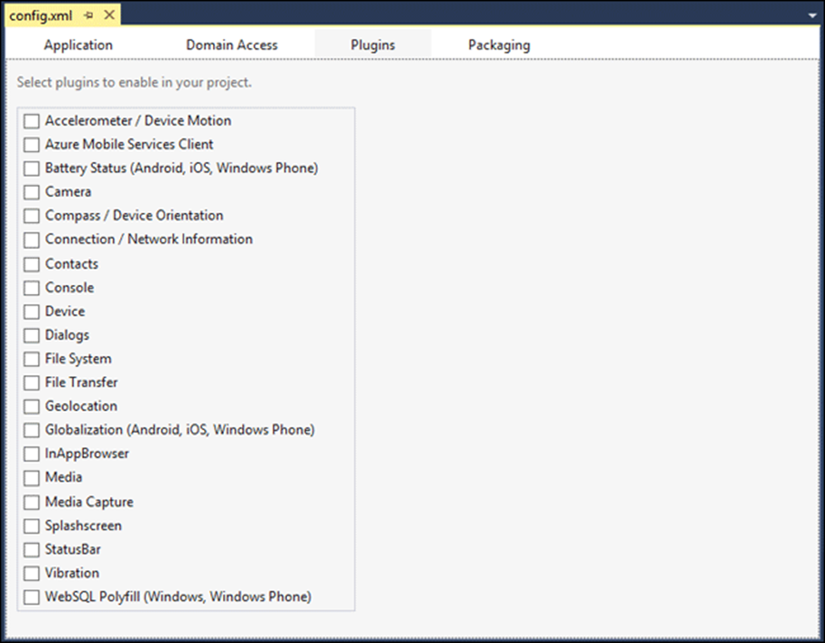
Implementing Apache Cordova Plugin APIs
The Apache Cordova library provides a basic set of APIs that are made available by various plugins.
These plugins need to be enabled in the app’s config.xml file.
Alternatively, you need to install the plugin on your system by executing the following command in the working directory of the app:
cordova plugin add org.apache.cordova.camera
Various Plugins Under the Plugins Tab

Slide 12
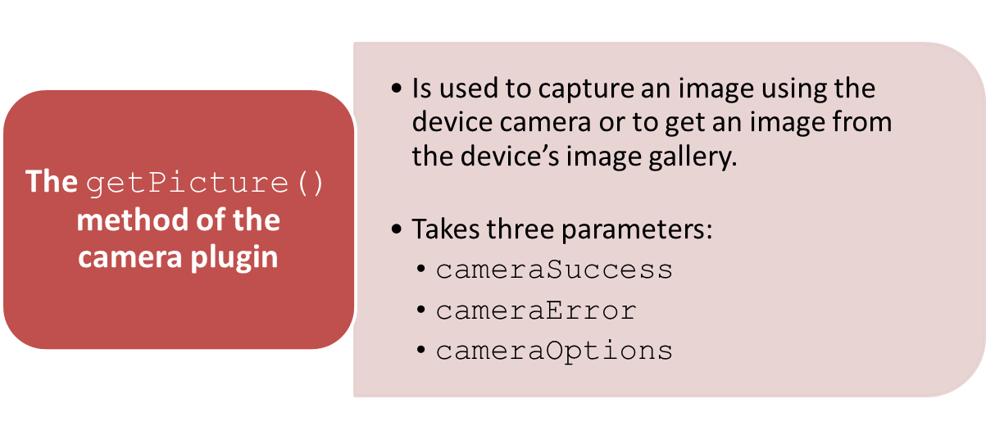
Implementing Apache Cordova Plugin APIs (Contd.)
Camera
To install the camera plugin, execute the following command on the command line:
cordova plugin add org.apache.cordova.camera

Slide 13
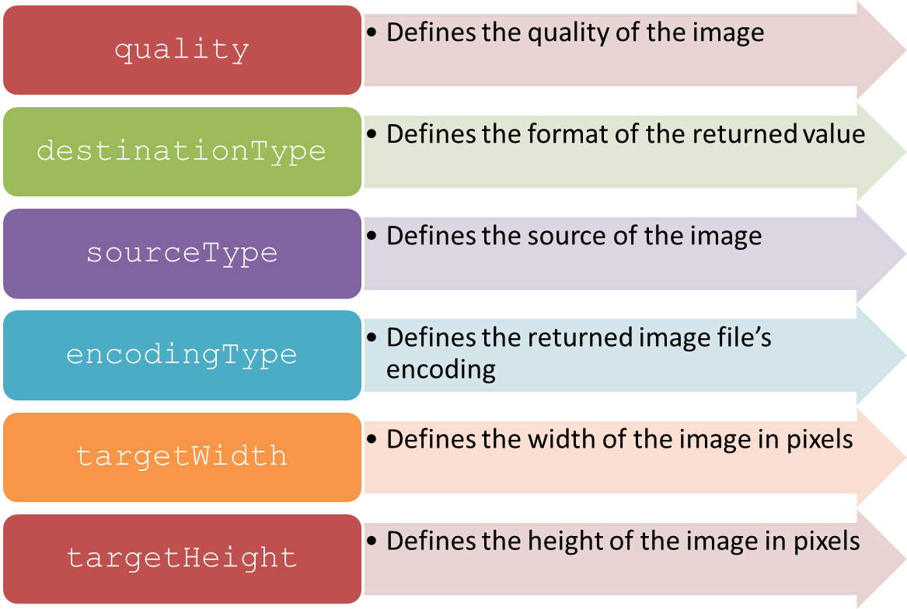
Implementing Apache Cordova Plugin APIs (Contd.)
The following optional parameters are used to customize the camera settings:

Slide 14
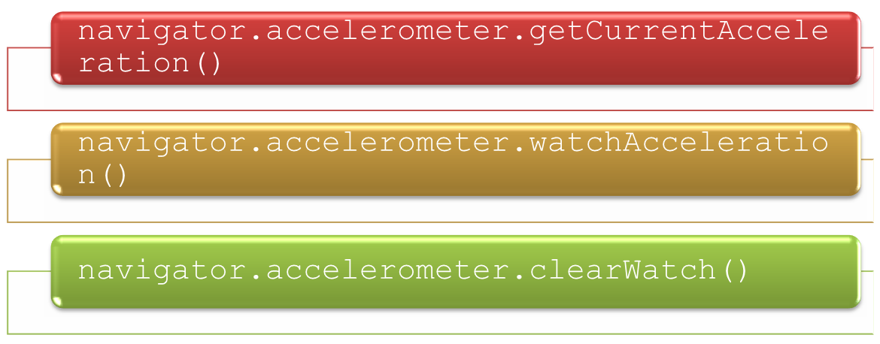
Implementing Apache Cordova Plugin APIs (Contd.)
Device Motion (Accelerometer)
The device motion plugin provides an API for accessing the accelerometer of the device.
To install this plugin, you need to execute the following command:
cordova plugin add org.apache.cordova.device-motion
The following methods are provided by this API to access the accelerometer of the device:

Slide 15


Implementing Apache Cordova Plugin APIs (Contd.)
The getCurrentAcceleration() Method
The getCurrentAcceleration() method gets the current acceleration of the device along the x, y, and z axis.
The following code snippet can be used to get the acceleration from the device accelerometer using the getCurrentAcceleration() method :
The following code snippet depicts a sample implementation of the onSuccess callback function:
navigator.accelerometer.getCurrentAcceleration(onSuccess, onError);
function onSuccess(acceleration)
{
alert('Acceleration X: ' + acceleration.x + '\n' + 'Acceleration Y: ' + acceleration.y + '\n'
+ 'Acceleration Z: ' + acceleration.z + '\n'
+ 'Timestamp: ' + acceleration.timestamp + '\n');
};

Slide 16

Implementing Apache Cordova Plugin APIs (Contd.)
The watchAcceleration() Method
The watchAcceleration() method retrieves the current acceleration of the device at a regular interval as shown in the following code snippet:
In the preceding code snippet, the onSuccess callback function gets the device’s acceleration.
The onError callback function is executed when there is an error
in retrieving the device’s acceleration.
var watchID = navigator.accelerometer.watchAcceleration(onSuccess, onError, options);

Slide 17

Implementing Apache Cordova Plugin APIs (Contd.)
The clearWatch() Method
The clearWatch() method stops watching the acceleration set by the watchAcceleration() method.
The watchID parameter is passed as a parameter to this method.
The following code snippet depicts the implementation of the clearWatch() method:
navigator.accelerometer.clearWatch(watchID);

Slide 18
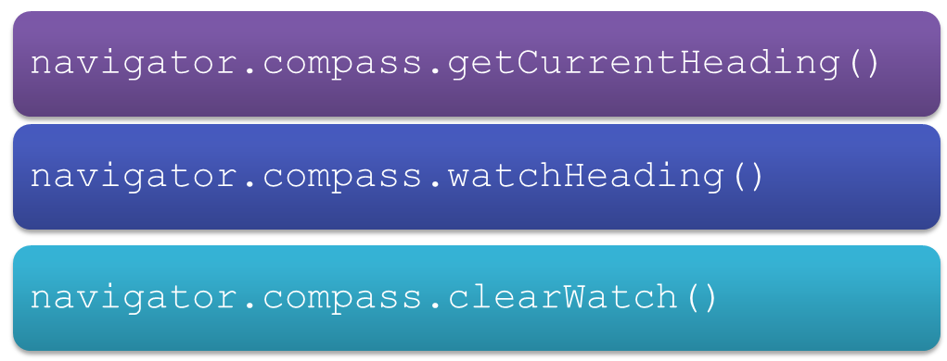
Implementing Apache Cordova Plugin APIs (Contd.)
Device Orientation (Compass)
The device orientation plugin provides an API for accessing the compass of the device.
To install this plugin, execute the following command on the command line:
cordova plugin add org.apache.cordova.device-orientation
The following methods are provided by this API to access the compass of the device:

Slide 19
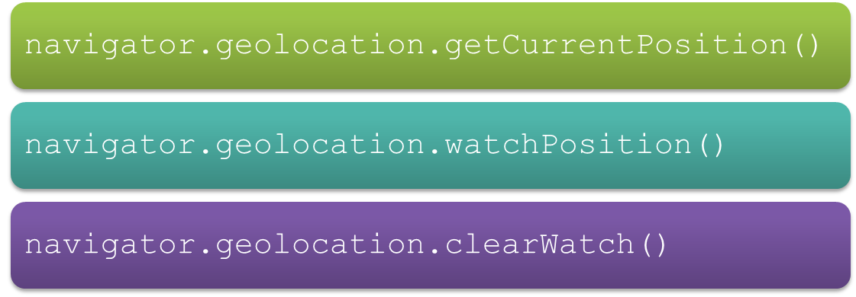
Implementing Apache Cordova Plugin APIs (Contd.)
Geolocation
The geolocation plugin provides information about the location of the device, such as latitude and longitude retrieved from the Global Positioning System (GPS).
To install this plugin, execute the following command on the command line:
cordova plugin add org.apache.cordova.geolocation
The following methods are provided by this plugin to access the location of the device:

Slide 20
Activity 10.3: Implementing Apache Cordova Plugin APIs
Problem Statement:
Maria is working as an app developer in Global Soft Inc. She has been assigned a task to develop a cross-platform app that captures an image from the device camera on the click of a button and displays the captured image to the user. Help Maria to develop the required app.
Solution:
To complete this activity, you need to perform the following steps:
  Create a project.
  Add camera plugin.
  Add the UI elements.
  Make the app functional.
  Execute the app and verify the output.

Slide 21

Just a Minute
Which one of the following methods is used to get the current location of the device once?
navigator.geolocation.getCurrentPosition
navigator.geolocation.watchPosition
navigator.geolocation.clearWatch
Answer:
1. navigator.geolocation.getCurrentPosition

Slide 22
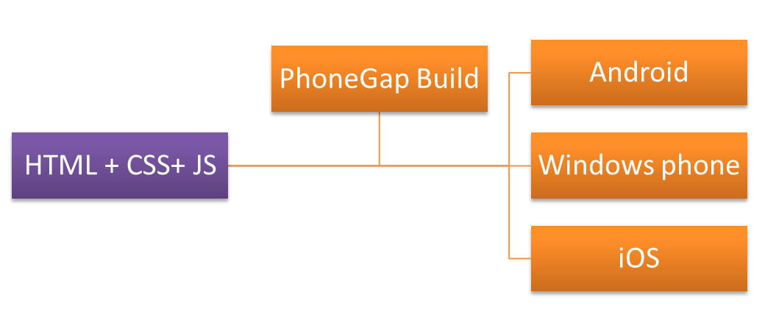
Working with PhoneGap Build
To deploy a mobile app on a device, you need to generate an executable file of the app.
You require native SDKs of each platform to generate different executable files for different platforms.
PhoneGap Build is a cloud service that allows you to upload the HTML5, JavaScript, and CSS3 assets of your Web application project .
With a single upload, it generates the executable files of the various platforms, such as Windows Phone and Android.

Slide 23
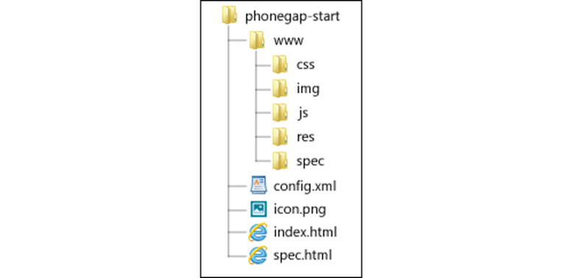
Setting up a Project for PhoneGap Build
To create a project for PhoneGap Build, you need to create a project structure that contains several files and directories.
The files contain the app’s source code, resource files, and configuration files.
The following figure shows a typical directory structure of a project for PhoneGap Build.
Typical Directory Structure of a Project for PhoneGap Build

Slide 24
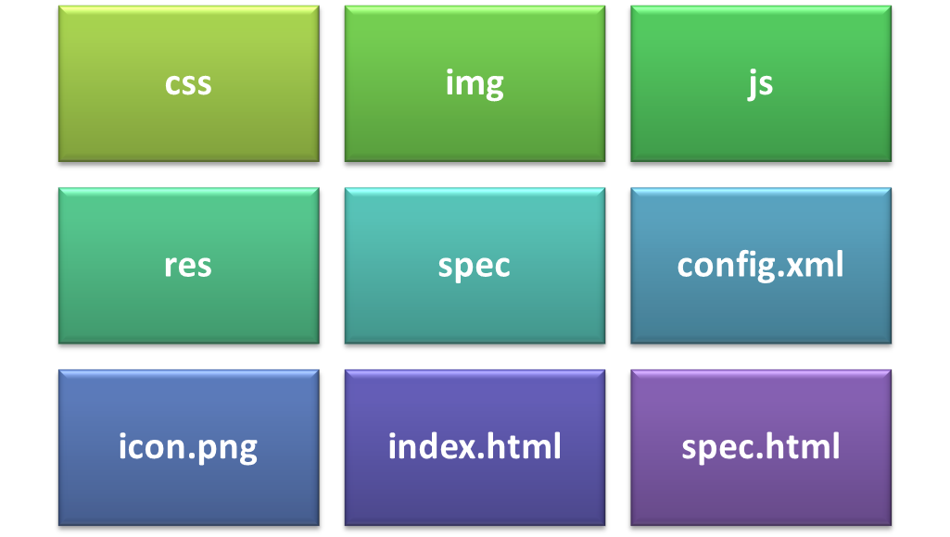
Setting up a Project for PhoneGap Build (Contd.)
A project for PhoneGap Build contains the following directories and files:

Slide 25
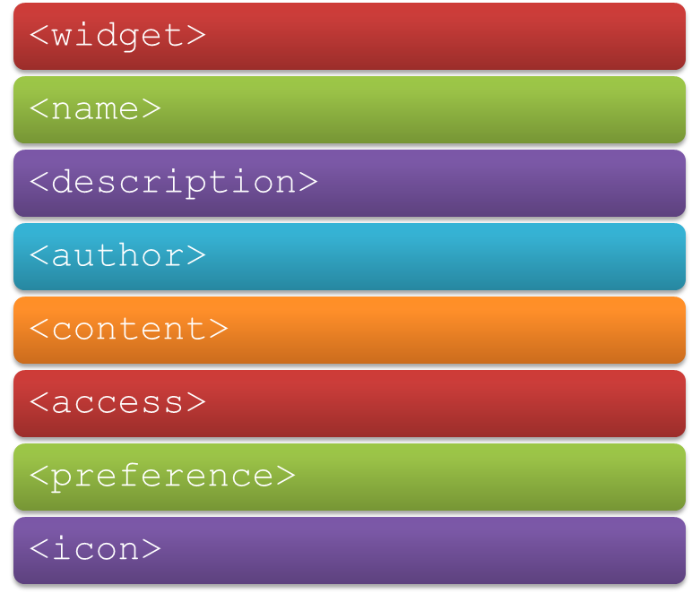
Structure of the Config File
The config.xml file contains the information associated with the deployment of the app.
This file allows specifying various properties by using the following elements:

Slide 26
Installing and Setting up GitHub
Instead of creating project structure manually, you can access the default project structure from the GitHub repository.
For this, you need to have an account on GitHub and GitHub installed on your machine.
Once GitHub is installed and set up, you need to fork a project from the GitHub repository and sync it on your system.
You can start the development of your app by modifying the code in the default template.

Slide 27
Task 10.4: Installing and Setting up GitHub

Slide 28
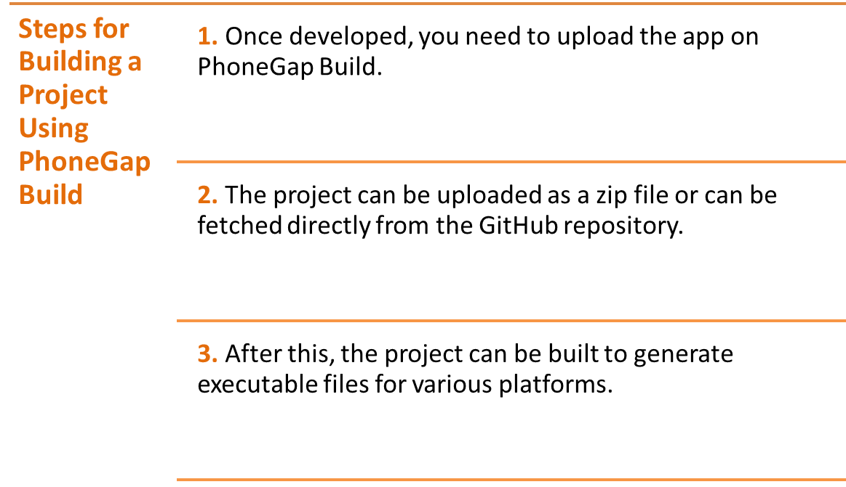
Building the Project Using PhoneGap Build

Slide 29
Deploying a xap File on a Device/Emulator
The executable file generated from PhoneGap Build can be deployed on the emulator.
The executable file can also be deployed on the device by scanning the Quick Response (QR) code generated by PhoneGap Build.
Once the QR code generated by PhoneGap is scanned, the executable file of the app is downloaded to the device. The user can then install the app on the device.

Slide 30
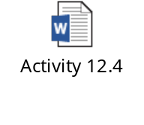
Activity 10.4: Building a Cross-Platform App for PhoneGap Build
Problem Statement:
Solution:
To complete this activity, you need to perform the following steps:
  Clone the phonegap-start repository.
  Modify the code.
  Pull the project from .git repository in PhoneGap Build.
  Execute the app and verify the output.

Slide 31
Summary
In this session, I learned that:

